Slide 1
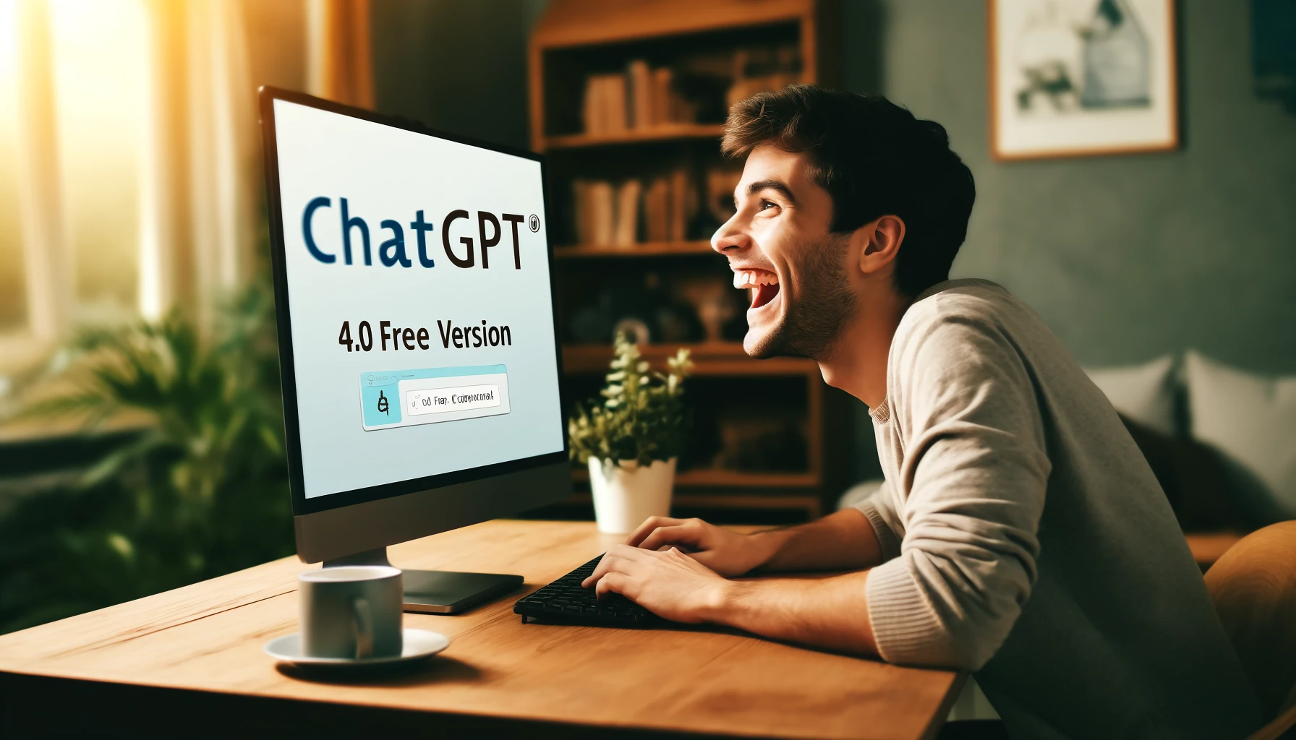
How to Really Use
ChatGPT 4o
Free Version

Slide 2




Notes:
https://www.youtube.com/channel/UC35ZpwldGw7ZJ5R-2sLijzw

Slide 3

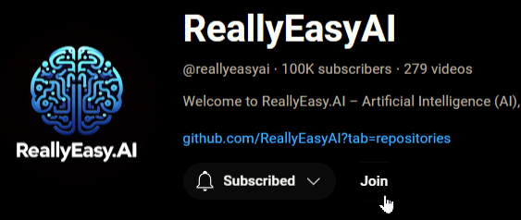
Membership has its privileges
Notes:
https://www.youtube.com/channel/UC35ZpwldGw7ZJ5R-2sLijzw/join

Slide 4
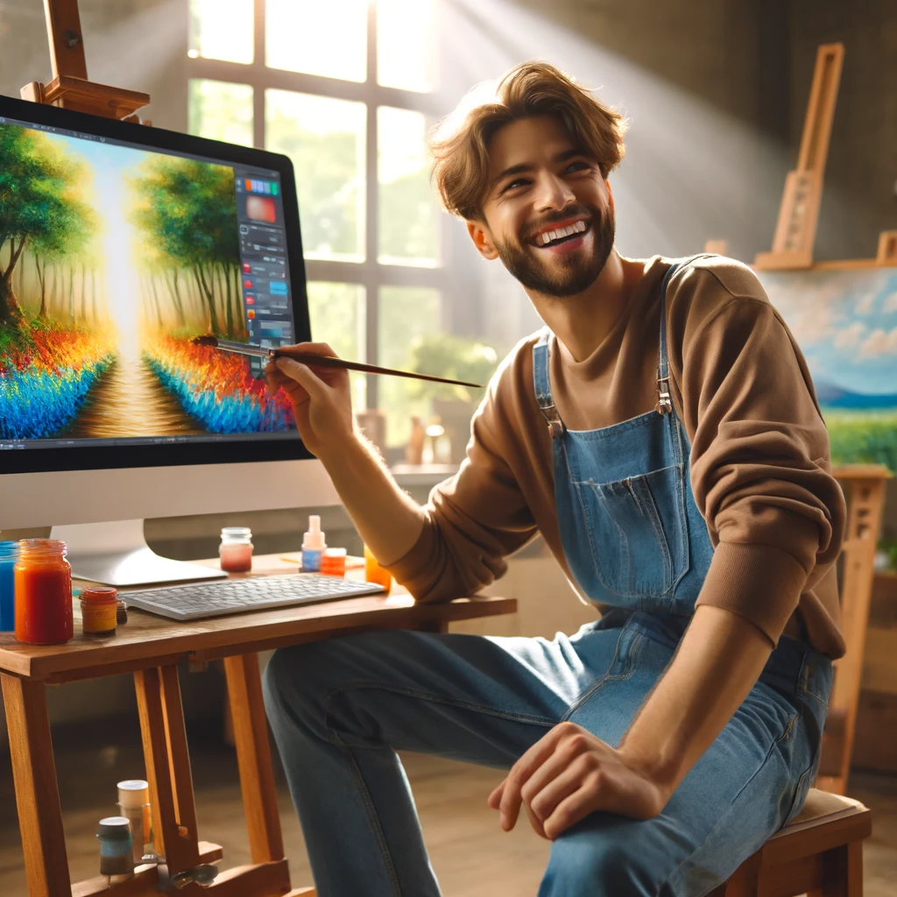
Creating images

Slide 5
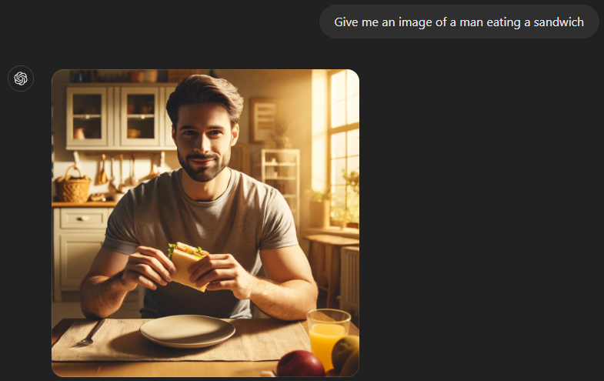
Simple images
Notes:
Give me an image of a man eating a sandwich

Slide 6
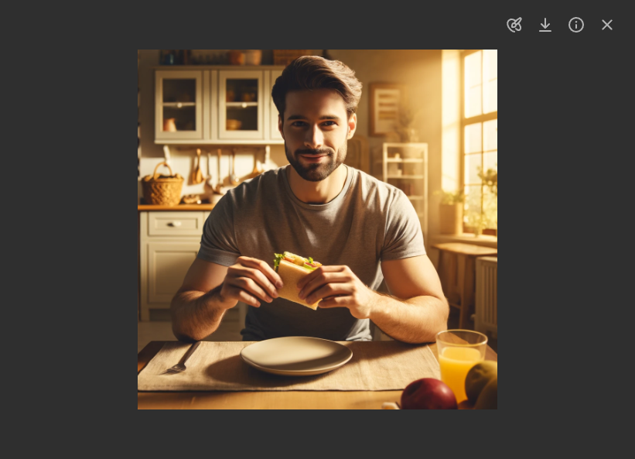
Using the Image editor

Slide 7
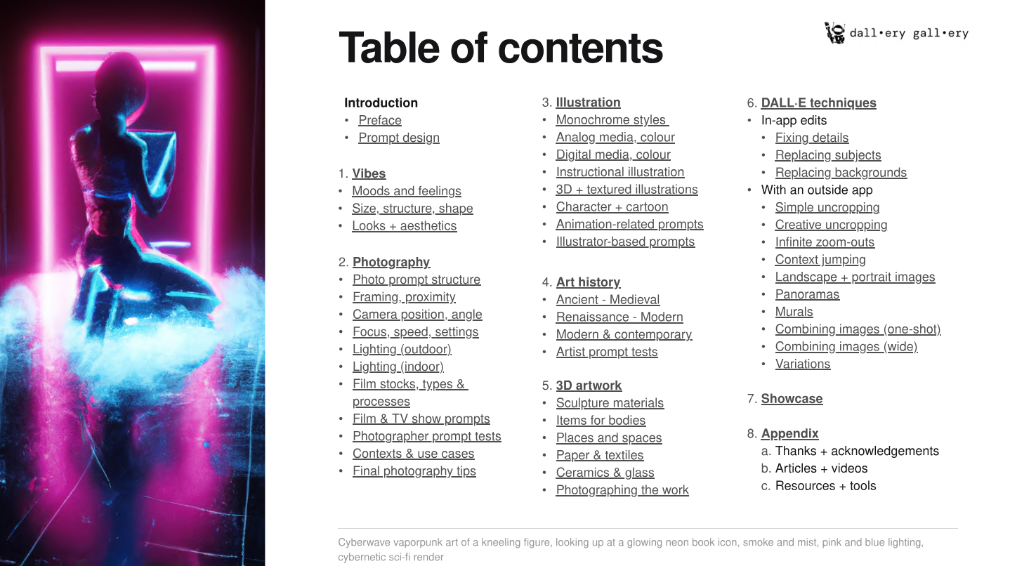
the possibilities are limitless
Notes:
Give me an image of a Cyberwave vaporpunk art of a kneeling figure, looking up at a glowing neon book icon, smoke and mist, pink and blue lighting, cybernetic sci-fi render
https://dallery.gallery/wp-content/uploads/2022/07/The-DALL%C2%B7E-2-prompt-book-v1.02.pdf

Slide 8
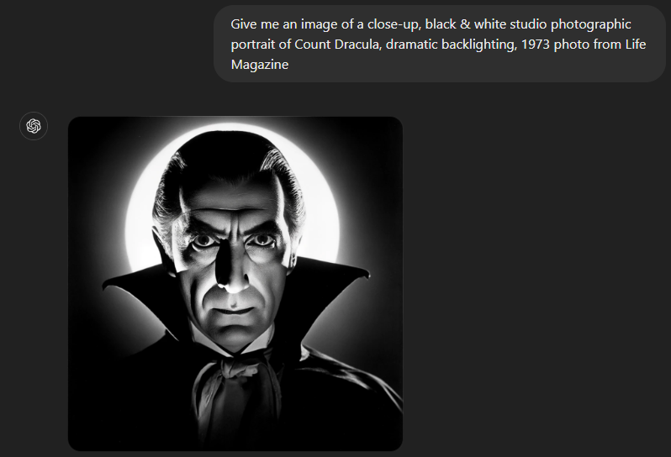
Photography
Notes:
Give me an image of a close-up, black & white studio photographic portrait of Count Dracula, dramatic backlighting, 1973 photo from Life Magazine
Give me an image of a vibrant realistic photograph of Count Dracula, wide shot, outdoors, sunset photo at golden hour, wide-angle lens, soft focus

Slide 9
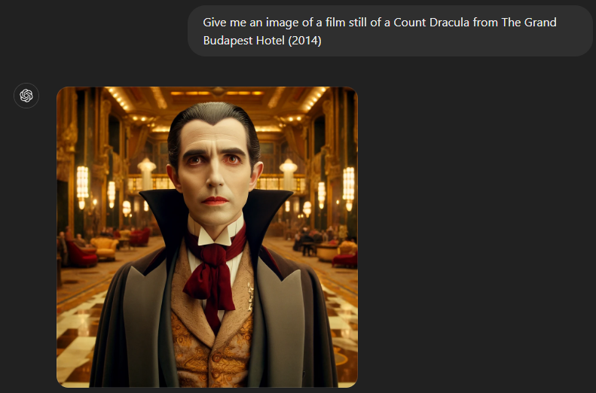
Style from film
Notes:
Give me an image of a film still of a Count Dracula from The Grand Budapest Hotel (2014)
Give me an image of Count Dracula at night walking the streets from Close Encounters of the Third Kind (1977)

Slide 10
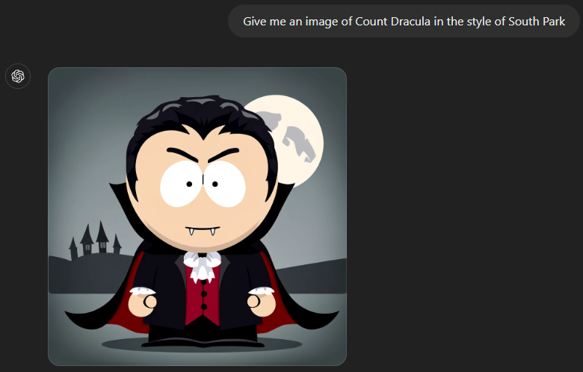
Style from animated tv shows / Films
Notes:
Give me an image of Count Dracula in the style of South Park
Give me an image of Count Dracula in the style of The Simpsons

Slide 11
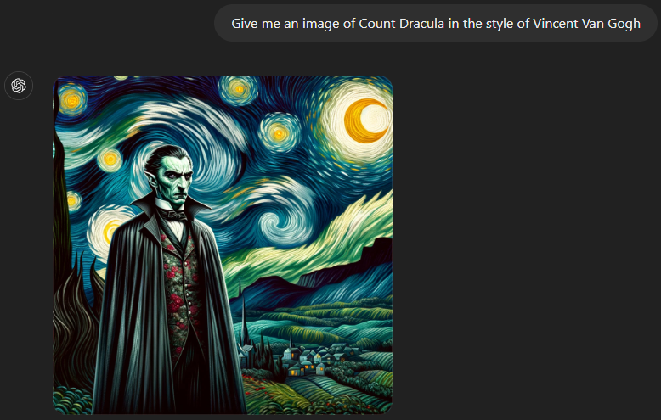
Artist based images
Notes:
Give me an image of Count Dracula in the style of Vincent Van Gogh
Give me an image of Count Dracula in the style of Pierre-Auguste Renoir

Slide 12
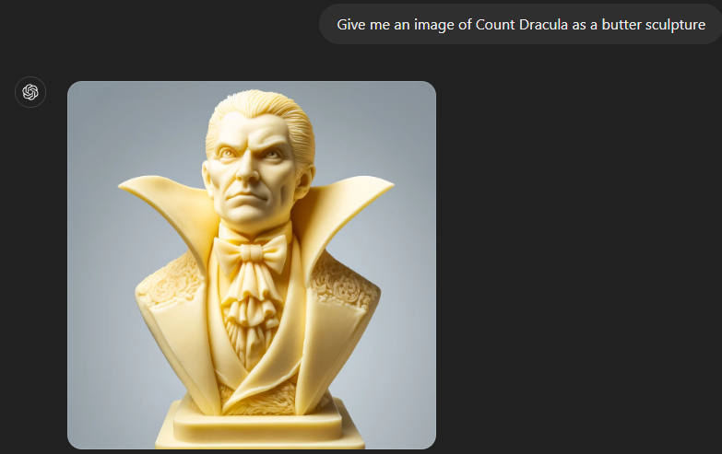
Various materials
Notes:
Give me an image of Count Dracula as a butter sculpture
Give me an image of Count Dracula in legos

Slide 13
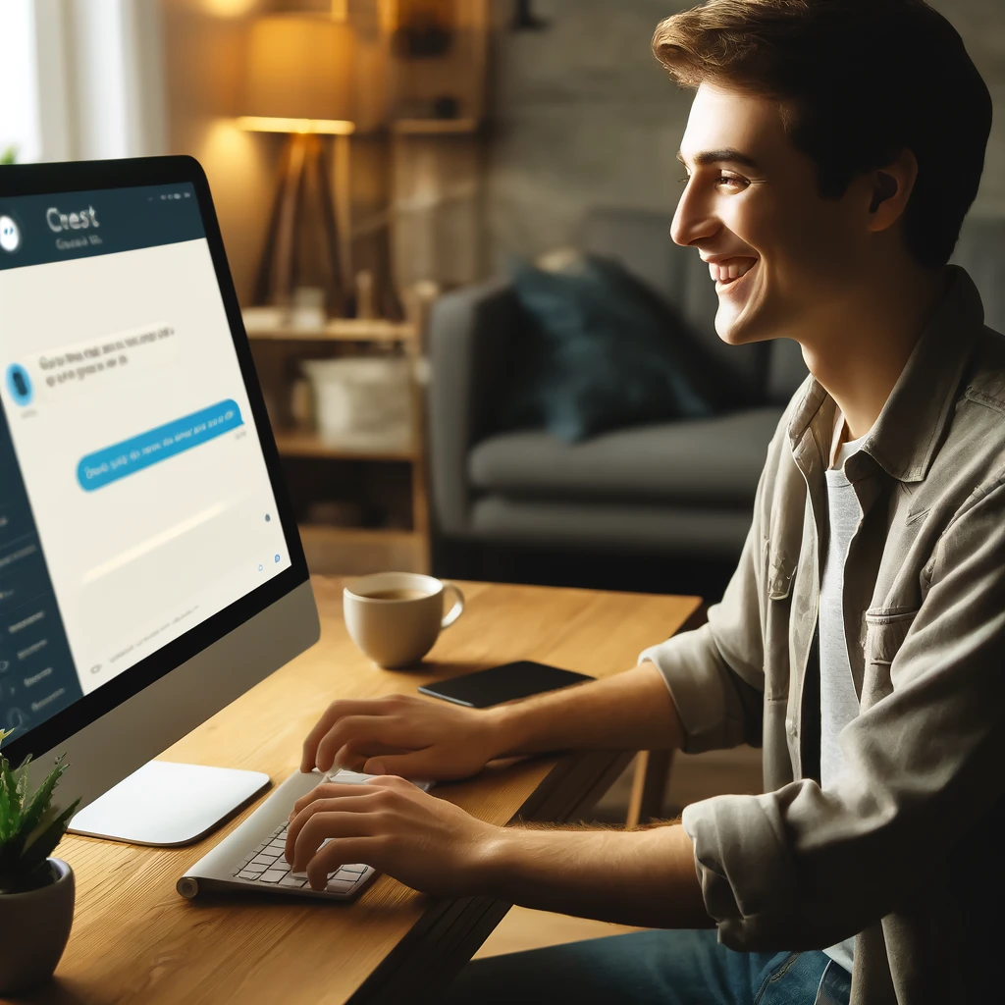
Using gpts

Slide 14
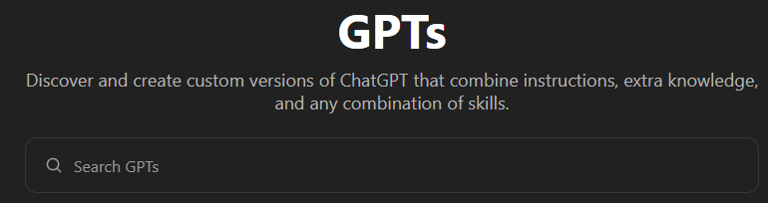
What is a gpt?

Slide 15
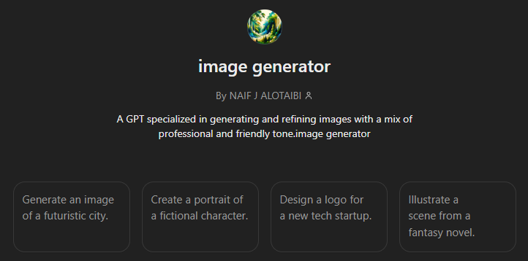
Using gpts

